Slide 1
Indexes

Slide 2









Icons Used
Hands on Exercise
Questions
Tools
Coding Standards
Test Your Understanding
Reference
A Welcome Break
Contacts
Demonstration

Slide 3
Indexes Overview
At the end of this session you will come to know:
Introduction
Working of Indexes
Indexes Types
Design Guidelines
Scan and Seek

Slide 4
Indexes: Objectives
Objective:
After completing this chapter you will be able to:
Describe the structure of Index and its types.
Efficient way of using Indexes

Slide 5
Indexes - What?
On-disk structures that support a speedy retrieval of data by providing a swift access to the rows of the table.
Indexes operate 'behind the scenes' in support of the database engine
ANALOGY: Index of the book

Slide 6
Indexes
An Index is made up of a set of pages (Index nodes) that are organized in a B-tree structure.
This structure is hierarchical in nature, with the root node at the top and the leaf nodes at the bottom.
The query engine moves from the root downwards, with each level getting more granular than the previous.

Slide 7
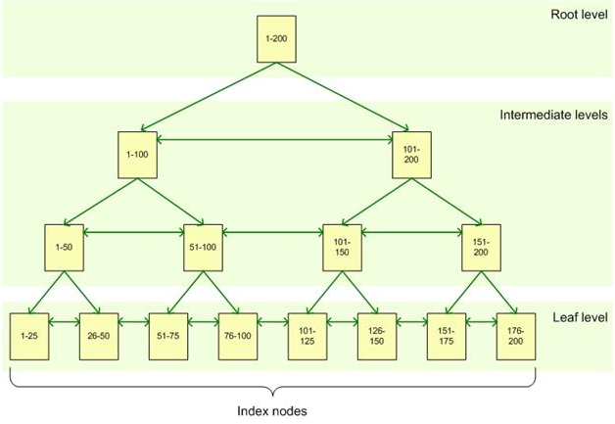
Index Structure
1,
101
1,
51
101, 151
1,
26
51,
76
101,
126
151,
176

Slide 8
Index Strategies
SCAN
Goes through all the rows of the table searching for a particular row
INDEX SCAN-Scans Index pages
SEEK
Makes use of the optimal paths
offered by the B Tree structure and narrows down on the record in minimal time.
INDEX SEEK-traverse via B-TREE Index structure from root the bottom level to return the data .

Slide 9
Indexes – Why?
To retrieve a particular row, a table would have to go through the entire table (TABLE SCAN) and get it.
This can have a significant effect on performance
So, we go for Indexes Where seek is performed rather than a Scan.

Slide 10
Indexes – How?
The B-tree structure supports fast searches with a minimum amount of disk reads.
Allows the database engine to quickly find the starting and stopping points for the query we are using.

Slide 11
Types of Indexes
Clustered Index
Non Clustered Index
Advancements in Indexes
Filtered Index
Partitioned Index
Composite Index
Index intersection

Slide 12
Clustered Index
ANALOGY: A phonebook – immediate access to all of the data.
Stores the actual data rows at the leaf level of the Index sorted by the Index key.
CREATE CLUSTERED INDEX
IDX_SupplierID
ON Products(SupplierID)

Slide 13
Contd…
We can have only one clustered Index per table.
Otherwise,
Cannot create more than one clustered Index on table 'Products'. Drop the existing clustered Index 'PK_Products' before creating another.

Slide 14
Contd…
A normal clustered Index can be on both unique and non unique columns.
Another variant is the UNIQUE CLUSTERED INDEX.
A table that has a clustered Index is referred to as a clustered table. A table that has no clustered Index is referred to as a heap.

Slide 15
Clustered Index - Drawbacks
We update a record and change the value of an Indexed column in a clustered Index.
This might lead the database to move the entire row into a new position to keep the rows in sorted order.

Slide 16
Non Clustered Index
The leaf nodes of a nonclustered Index contain only the values from the Indexed columns and row locators that point to the actual data rows.
So, the query engine must take an additional step in order to locate the actual data
After reaching the leaf node, it performs a key lookup. Here,
If the clustered Index is already present, Clustered Index Key is used.
Else, if its not present, it’s a HEAP.
In this case, rowid is used for the key lookup.

Slide 17
Non Clustered Index
We can have 249 NCI’s (SS 2005)
And, 999 NCI’s (SS 2008)
We can also add included columns to your Index.
This means that we can store at the leaf level not only the values from the Indexed column, but also the values from non-Indexed columns

Slide 18
What to use when?
Clustered Index
Non clustered Index

Slide 19
Uniquifier
consider a scenario where both the clustered Index and non clustered index are not unique.
Then how would it be possible to identify the records uniquely.
In such a case Uniquifier is used.
Values are recorded in the Uniquifier column to uniquely identify the rows.

Slide 20
Uniquifier
Nonclustered | Clustered | NCI_Uniquifier? | CI_Uniquifier?
NON UNIQUE | UNIQUE | - | -
UNIQUE | UNIQUE | - | -
NON UNIQUE | NON UNIQUE | - | YES
UNIQUE | NON UNIQUE | - | -
NON UNIQUE | - | YES | NA

Slide 21
Viewing the Uniquifier
--Get the pg number
DBCC IND(TEST_XML,tt,-1)
--Viewing the page
DBCC TRACEON(3604)
DBCC PAGE(TEST_XML,1,227,1)
--Also, Uniquifier added only upon seeing the first duplicate row.

Slide 22
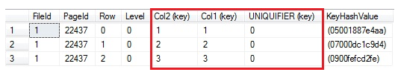
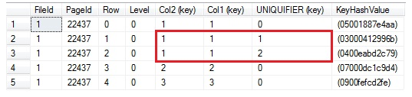

Slide 23
Filtered Index
A filtered Index is an optimized nonclustered Index
suited to cover queries that select from a well-defined subset of data.
It uses a filter predicate to Index a portion of rows in the table.

Slide 24
Advantages of filtered Index
Improved query performance and plan quality
Reduced Index maintenance costs
Reduced Index storage costs

Slide 25
Partitioned Index
Index is created for all the individual partitions.
Aligned Index: An Index that is built on the same partition scheme as its corresponding table. When a table and its Indexes are in alignment, SQL Server can switch partitions quickly and efficiently while maintaining the partition structure of both the table and its Indexes.

Slide 26
Partitioned Index(2)
Nonaligned Index: An Index partitioned independently from its corresponding table. That is, the Index has a different partition scheme or is placed on a separate filegroup from the base table. Designing an nonaligned partitioned Index can be useful in the following cases:
The base table has not been partitioned.
The Index key is unique and it does not contain the partitioning column of the table.
We want the base table to participate in co-allocated joins with more tables using different join columns.

Slide 27
Indexes – Creation
CREATE [ UNIQUE ] [ CLUSTERED | NONCLUSTERED ] INDEX Index_name
ON <object> ( column [ ASC | DESC ] [ ,...n ] ) [ INCLUDE ( column_name [ ,...n ] ) ]
[ WHERE <filter_predicate> ]
[ WITH ( <relational_Index_option> [ ,...n ] ) ]
[ ON { partition_scheme_name ( column_name ) | filegroup_name | default } ]
[ FILESTREAM_ON { filestream_filegroup_name | partition_scheme_name | "NULL" } ] [ ; ] ]
Also done via the GUI – selecting the Indexes option under the respective table
EXEC sp_helpIndex t_name – to view Indexes

Slide 28
Data types that support Indexes
We can create Indexes on most columns except columns configured with large object (LOB) data types, such as ntext, text, image, varchar(max), nvarchar(max) and varbinary(max)
However varchar(max), nvarchar(max), varbinary(max), and xml can qualify to be non key Indexes.

Slide 29
Fill Factor
Deals with the percentage of the page that is
To be filled
to be set aside for future modifications to the existing rows in the page.
The fill factor ranges from 1 to 100.
By default , it is 100.

Slide 30
Composite Index
Index based upon more than one column
Used for:
Covering Queries
Improving the search efficiency
Ordering of the columns

Slide 31
Covering Queries
CREATE INDEX [IDX_UnitPrice]
ON Products (UnitPrice)
--covered
SELECT UnitPrice FROM Products ORDER BY UnitPrice
--Not covered
SELECT ProductName, UnitPrice FROM Products ORDER BY UnitPrice
--So,
CREATE INDEX [IDX_UnitPrice]
ON Products (UnitPrice,ProductName)
--Hence covered.
--Can also be achieved via INCLUDE

Slide 32
Search Efficiency
Ordering of the columns forming the Index
CREATE UNIQUE CLUSTERED INDEX PK_Order_Details ON [Order Details] (OrderID, ProductID)
--useful
SELECT * FROM [Order Details] WHERE OrderID = 11077 SELECT * FROM [Order Details] WHERE OrderID = 11077 AND ProductID = 13
--notuseful
SELECT * FROM [Order Details] WHERE ProductID = 13

Slide 33
Index Intersection
Index Intersection is a technique built to enable it to use more than one Index on a table to satisfy a given query.
It allows SQL Server to scan more than one relevant Index to get the data you need, minimizing the amount of data returns and maximizing performance.
Available from SS 7.0 onwards

Slide 34
Spatial Indexes
For creating indexes on spatial columns -Geometry, Geography
Geometry - supports geometric data-points, lines, and polygons within a Euclidean coordinate system.
Geography - maps the geographic data to a two-dimensional, non-Euclidean space.
Utilizes the B-Tree structure, but since they provide just a 2-D view, goes for a refactoring of the space into a 4-level grid hierarchy
Each level gets more granular than the previous.

Slide 35
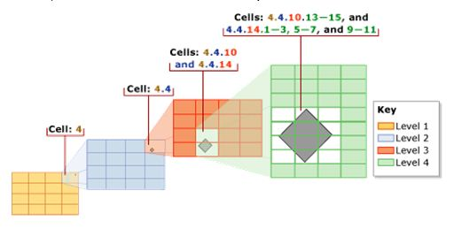
Contd…
Refactoring of space done via a tessellation process.
Fits in the space represented by the data into the previously created grid hierarchy with a series of gaps or overlaps.

Slide 36
Contd…
Three rules govern the tessellation:
Covering Rule – If an object completely covers a cell and overlaps into other cells then the cell is recorded in the index and no other attempt is made to maneuver other objects against that cell
Cells per Object Rule - A limit on the number of objects that tessellation can occur with in a given cell.
Deepest cell Rule - recording only the information required in the deepest cell

Slide 37
Contd…
CREATE SPATIAL INDEX index_name
ON <object> ( spatial_column_name )
{
[ USING <geometry_grid_tessellation> ]
WITH ( <bounding_box>
[ [,] <tesselation_parameters> [ ,...n ] ]
[ [,] <spatial_index_option> [ ,...n ] ] )
| [ USING <geography_grid_tessellation> ]
[ WITH ( [ <tesselation_parameters> [ ,...n ] ]
[ [,] <spatial_index_option> [ ,...n ] ] ) ]
}
[ ON { filegroup_name | "default" } ]
;

Slide 38
DMV’s for Indexes
sys.dm_db_Index_usage_stats
used to get useful information about the Index usage for all objects in all databases.
shows the amount of seeks and scan for each Index.
SELECT object_id, Index_id, user_seeks, user_scans, user_lookups FROM sys.dm_db_Index_usage_stats ORDER BY object_id, Index_id

Slide 39
DMV’s for Indexes(2)
To know the unused Indexes
SELECT object_name(i.object_id), i.name, s.user_updates, s.user_seeks, s.user_scans, s.user_lookups from sys.Indexes i left join sys.dm_db_Index_usage_stats s on s.object_id = i.object_id and i.Index_id = s.Index_id and s.database_id = 5 where objectproperty(i.object_id, 'IsIndexable') = 1 and s.Index_id is null or (s.user_updates > 0 and s.user_seeks = 0 and s.user_scans = 0 and s.user_lookups = 0) order by object_name(i.object_id)

Slide 40
Other Operations on Indexes
EXEC sp_helpIndex Customers
EXEC sp_rename 'Products.IX_UnitPrice', 'IX_Price'
--normal column
DROP Index Products.IX_Price
--primary key column
DROP INDEX Products.PK_Products
An explicit DROP INDEX is not allowed on Index 'Products.PK_Products'. It is being used for PRIMARY KEY constraint enforcement.

Slide 41
Design Guidelines
Large numbers of Indexes on a table affect the performance of the DML statements.
Indexes improve performance of view especially when they contain joins, aggregate functions etc.
Avoid Indexing small tables

Slide 42
Design Guidelines
Create nonclustered Indexes on columns that are used in predicates and join conditions in queries.
Have covering Indexes wherever needed.
Write queries that insert or modify as many rows as possible in a single statement

Slide 43
Design Guidelines
Keep the length of the Index key short for clustered Indexes
Consider the order of the columns if the Index will contain multiple columns
Have distinct Index Keys

Slide 44
Index - Advantages
Searching for records
Sorting records
Grouping records
Maintaining an unique column
-The query optimizer must go for the fastest and least resource intensive way of executing the incoming queries.
-So, goes for the best Index for providing the best execution plan.

Slide 45
Indexes - Drawbacks
Data Modifications
In case of Bulk operation we can go for DROPPING the Index and Rebuilding it again.
Disk Space used
EXEC sp_spaceused t_name

Slide 46
Case study
At what scenario, it is better to use a unique non clustered Index on the primary key column, and place the clustered Index on some other column ?
Example: If majority of searches are on some other column rather than a primary key column, the clustered Index could be more effective if it is used on that field.

Slide 47
Test Your Understanding
Why do we go for Indexes?
Mention the major types of Index.
When does scan and seek happen?
What is uniquifier?

Slide 48
Index Summary
We learned how to create, manage, and select Indexes for SQL Server tables
Proper Indexes are crucial for good performance in large databases
Choose the Index depending upon the requirements.

Slide 49
Indexes -sources
http://msdn.microsoft.com/en-us/library/ms188783.aspx
http://msdn.microsoft.com/en-us/library/ms191195(v=sql.105).aspx
http://odetocode.com/articles/70.aspx
http://www.simple-talk.com/sql/learn-sql-server/sql-server-Index-basics/
http://www.mssqltips.com/sqlservertip/2082/understanding-and-examining-the-uniquifier-in-sql-server/

Slide 50
Indexes - sources
http://www.codeproject.com/Articles/173275/Clustered-and-Non-Clustered-Index-in-SQL-2005
http://technet.microsoft.com/en-us/library/bb934196(v=sql.105).aspx
http://technet.microsoft.com/en-us/library/bb964712(v=sql.105).aspx
http://www.mssqltips.com/sqlservertip/1976/sql-server-2008-spatial-index-performance/

Slide 51

You have successfully completed SQL Server Indexes concepts

